Slide 1
Sensitivity Analysis in R
Decision Modeling in R workshop

Slide 2
Sensitivity Analysis
What is the optimal strategy across a plausible range of input parameter?
Deterministic sensitivity analysis (DSA)
One-way analysis: vary one parameter, hold rest fixed
Two-way analysis: vary two parameters, hold rest fixed
What is the uncertainty around the CEA outcomes ?
Probabilistic sensitivity analysis (PSA)
Simultaneously vary input parameters by randomly sampling from appropriate probability distributions
How often is each alternative cost-effective?
What strategy has the highest expected net benefit
What is the optimal value of input parameter given λ?
Threshold Analysis

Slide 3
Deterministic Sensitivity Analysis

Slide 4
One-Way Sensitivity Analysis
Systematically vary a single parameter over range of uncertainty, keeping all others fixed
p_PCed = 30%, p_PCed = 40%, p_PCed = 50%, etc…
For each parameter value, calculate the expected outcomes under each strategy
Identify which strategy is preferred for each parameter value

Slide 5
One-Way Sensitivity Analysis
Probability of early detection (Primary care) | Deaths per 1,000
 | EV ‘Do Nothing’ | EV ‘Spray’ | EV ‘Test’
30% | 0.33 | 1.05 | 0.37
35% | 0.67 | 1.10 | 0.53
40% | 1.00 | 1.15 | 0.70
45% | 1.33 | 1.20 | 0.87
50% | 1.67 | 1.25 | 1.03
55% | 2.00 | 1.30 | 1.20
60% | 2.33 | 1.35 | 1.37
65% | 2.67 | 1.40 | 1.53

Slide 6
One-Way Sensitivity Analysis
Probability of early detection (Primary care) | Life Expectancy
 | Routine practice | Primary Care | Hospital Care
30% | 3.1 | 2.8 | 3.7
35% | 3.1 | 3.1 | 3.7
40% | 3.1 | 3.4 | 3.7
45% | 3.1 | 3.7 | 3.7
50% | 3.1 | 4.0 | 3.7
55% | 3.1 | 4.3 | 3.7
60% | 3.1 | 4.6 | 3.7
65% | 3.1 | 4.9 | 3.7

Slide 7
One-Way Sensitivity Analysis
Systematically vary a single parameter over range of uncertainty, keeping all others fixed
p.PCed = 30%, p.PCed = 40%, p.PCed = 50%, etc…
For each parameter value, calculate the expected outcomes under each strategy
Identify which strategy is preferred
‘Hospital Care’
‘Primary care’
30%
65%
Life Expectancy
= Base case

Slide 8
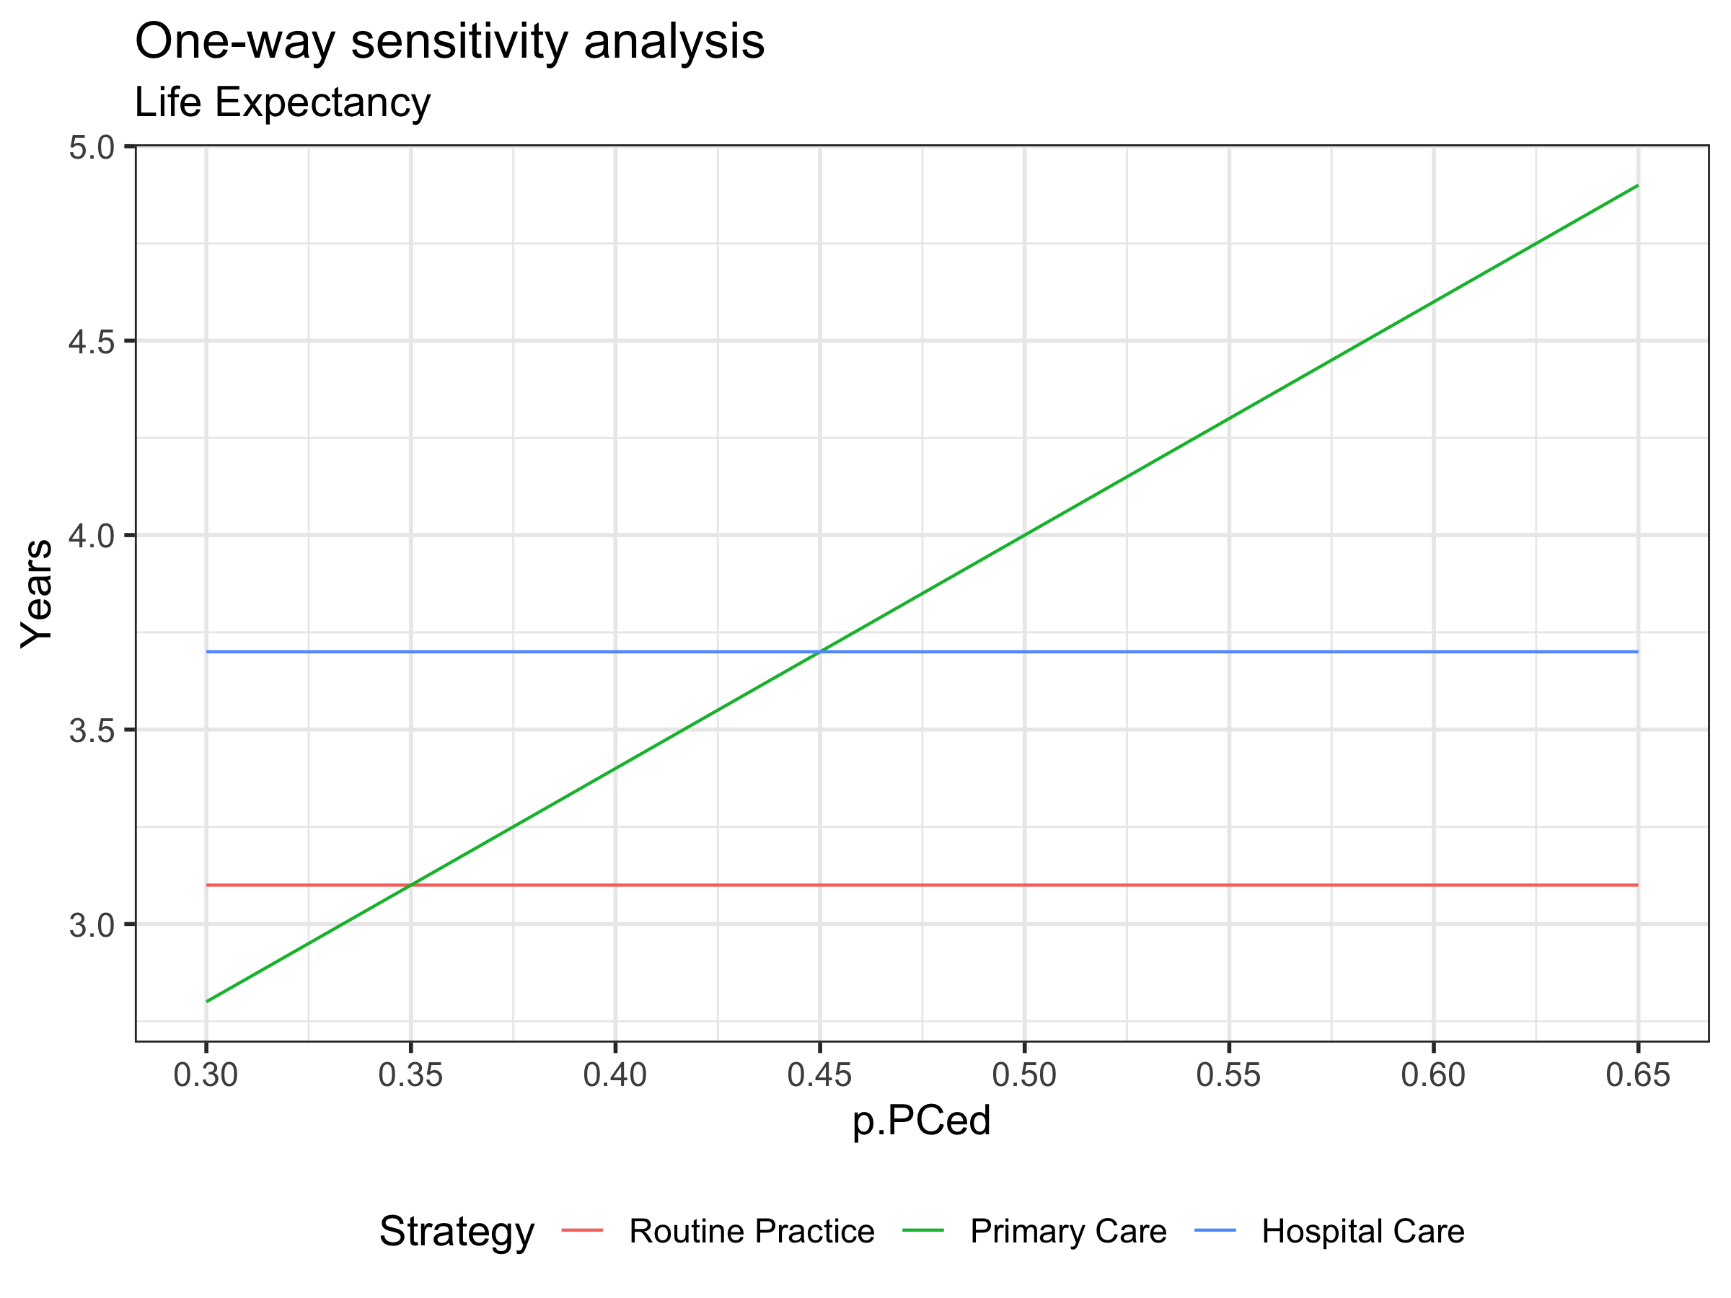
One-Way Sensitivity Analysis

Slide 9
Two-Way Sensitivity Analysis
Systematically vary two parameters over range of uncertainty, keeping all others fixed
p.PCed = 25%, p.HCed = 30%
p.PCed = 25%, p.HCed = 40%
p.PCed = 25%, p.HCed = 50%
p.PCed = 30%, p.HCed = 30%
p.PCed = 30%, p.HCed = 40%
etc…
Particularly useful if one parameter influences the impact of the other on the optimal decision

Slide 10
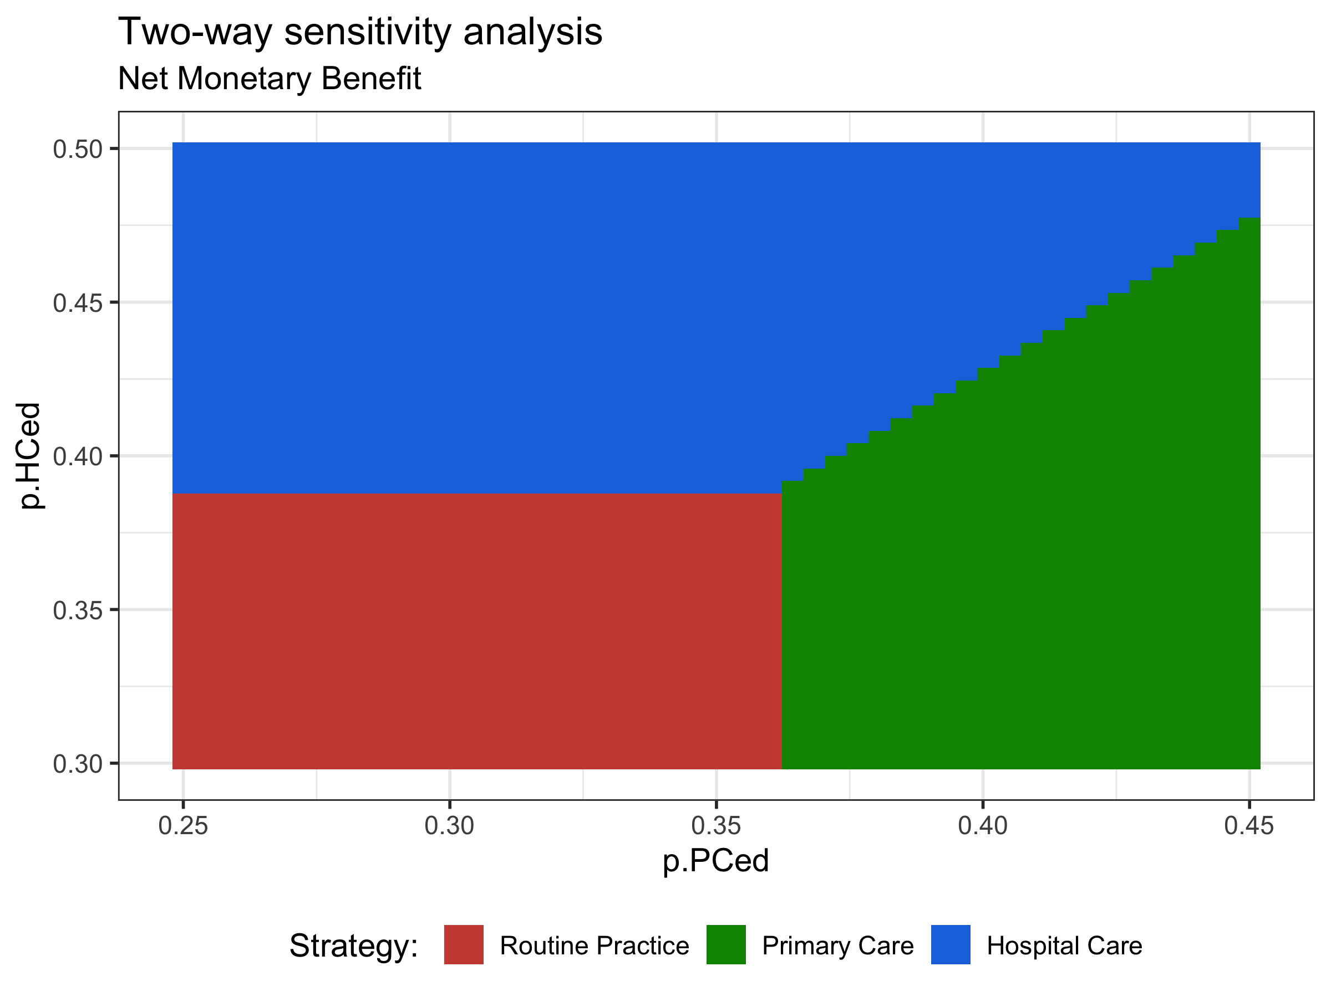
Two-Way Sensitivity Analysis

